Slide 1
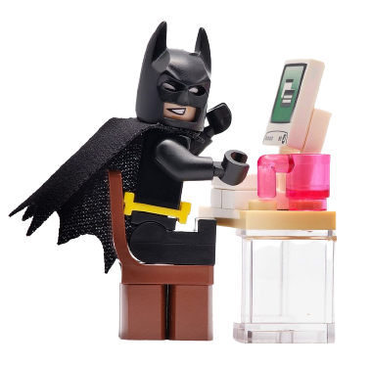
Young Programmer Challenge
Welcome!
Instructor: Bingxin Shen, Ph.D.
Teaching Assistants: Nitya Narayan and Will Liu
GPS IT@BMS
April 27, 2023

Slide 2


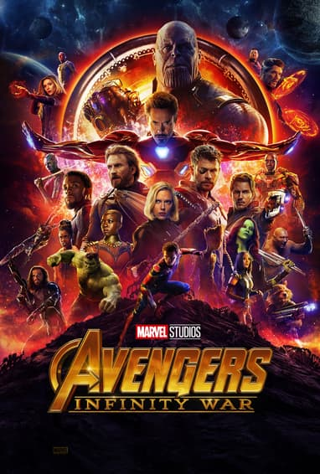
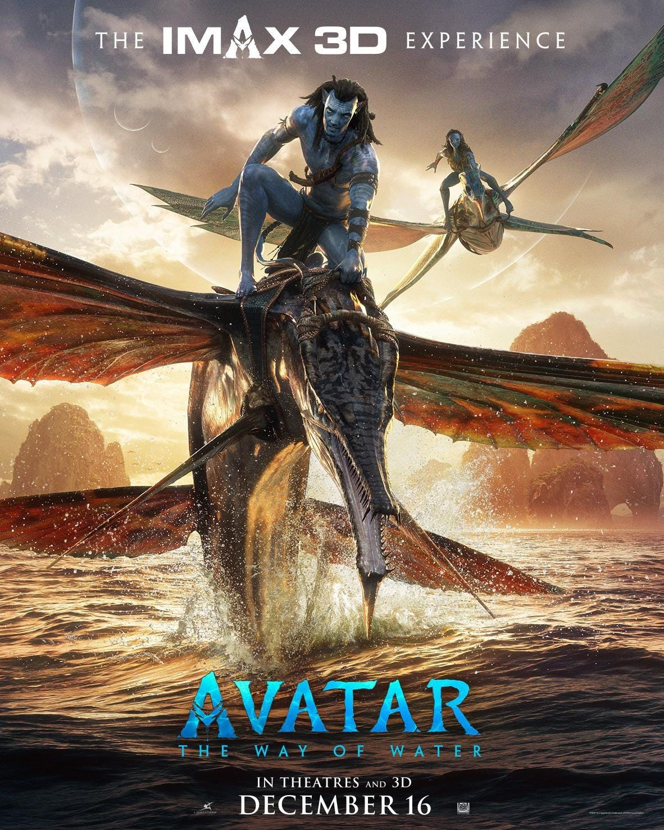

Let’s welcome each other
What is your Name?
What is your most wanted Superpower?

Slide 3
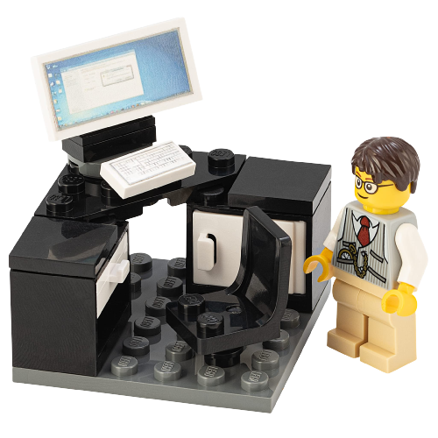
Agenda
Introduction to Programming
Tools we use for today
Project 1: function & parameters
Project 2: data visualization
Show your work!

Slide 4
Agenda
Introduction to Programming
Tools we use for today
Project 1: function & parameters
Project 2: data visualization
Show your work!

Slide 5

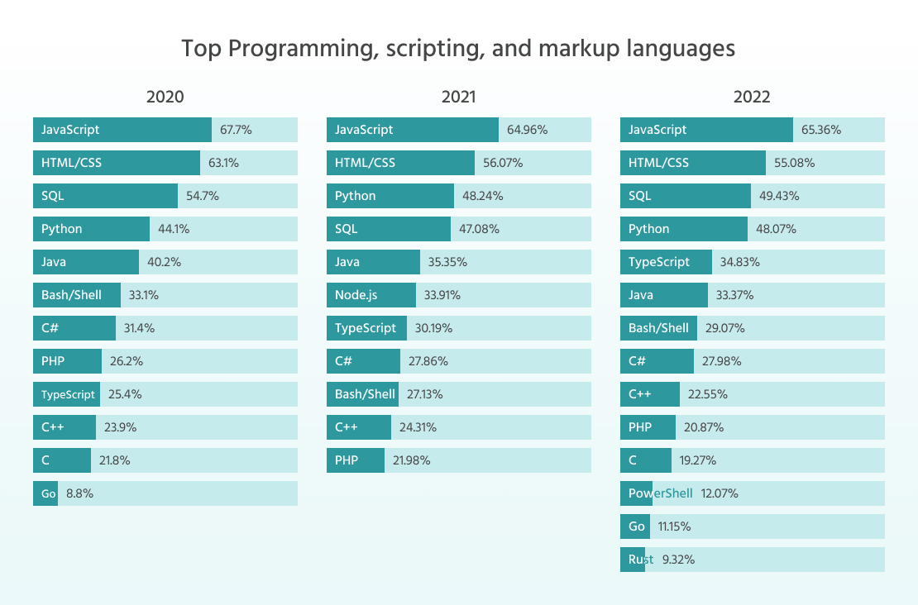
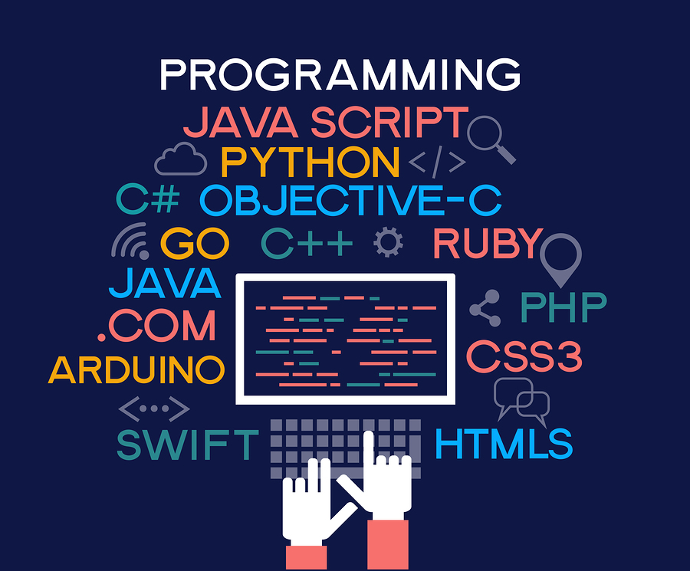
What is Programming?
Programming is the process of creating a set of instructions
Instructions to tell a computer how to perform a task in steps
Programming can be done using a variety of computer languages
Notes:
Your phone, car, fridge, what else can you think about?
Algorithm: R, MATLAB, Python,
C++, Java
Database: SQL
Web: html and JavaScripts
And many many more!
Did any one already learning this superpower to talk to the computers?
Python is one of the easiest languages to learn and use, while at the same time being very powerful: It is one of the most used languages by highly productive professional programmers. Also Python is a free language! If you have your own computer, you can download it from the Internet....

Slide 6
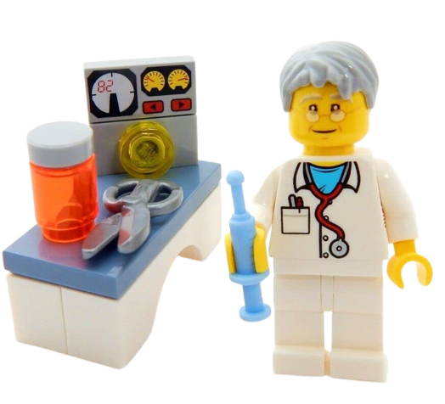
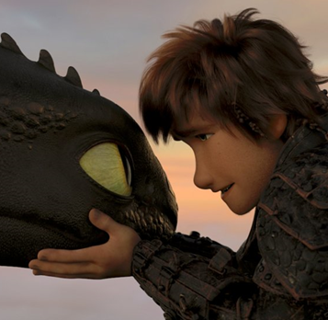



What do your parents do with programming at BMS?
Clinic trial study
Database management
Marketing and sales
And many many more!
Superpower to talk to dragons, snakes…

Slide 7
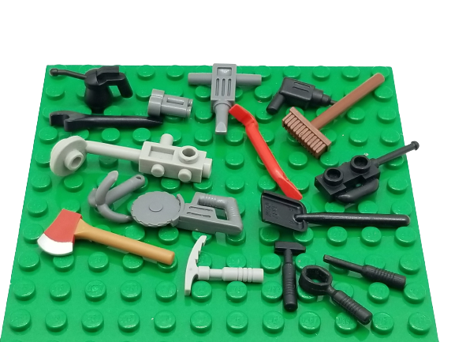
Agenda
Introduction to Programming
Tools we use for today
Project 1: function & parameters
Project 2: data visualization
Show your work!

Slide 8

Get ready
Log in to your laptop
Open the HandoutNotes on your desktop
Open a new window

Slide 9
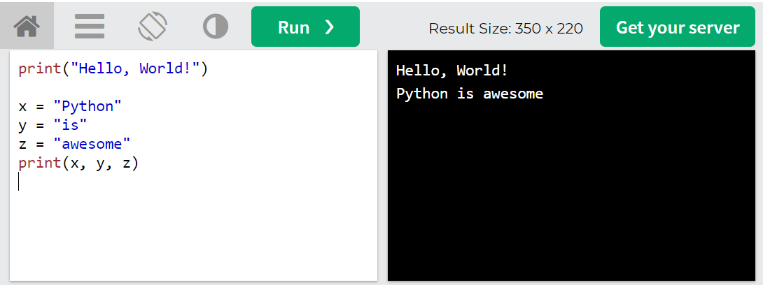
Python Online compiler
https://www.w3schools.com/python/trypython.asp?filename=demo_compiler
If you are interested in keeping on learning Python, here are more online tutorials: https://www.w3schools.com/python/

Slide 10
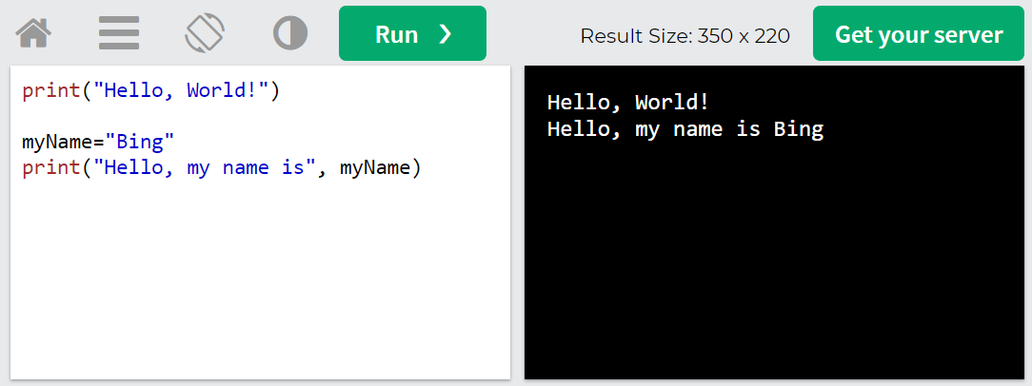

Try it yourself: Display String

Slide 11
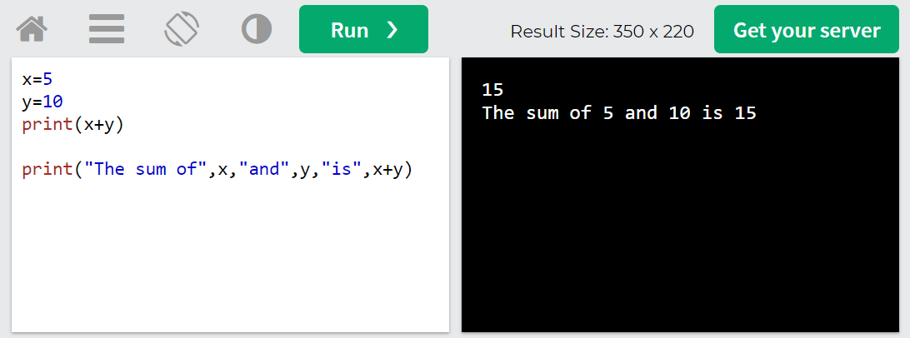
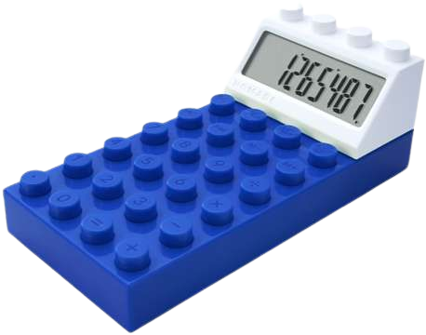
Display number (Optional)

Slide 12
Agenda
Introduction to Programming
Tools we use for today
Project 1: function & parameters
Project 2: data visualization
Show your work!

Slide 13
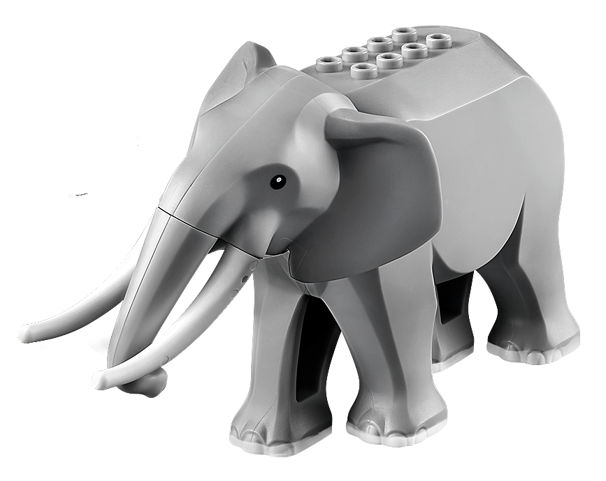
Function & Parameters
How do you put an elephant into a fridge?
open the fridge
put in the elephant
and close the door
How do you put a giraffe into a fridge?
open the fridge
put in the giraffe
and close the door
function PutAnimalInFridge(animal) {
open the fridge
put in the animal
and close the door
}

Slide 14
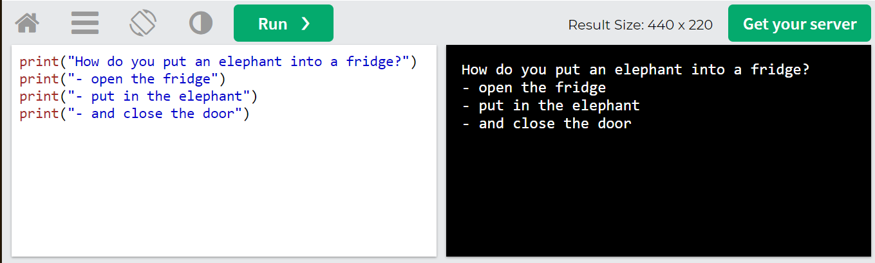
Hard coded

Slide 15
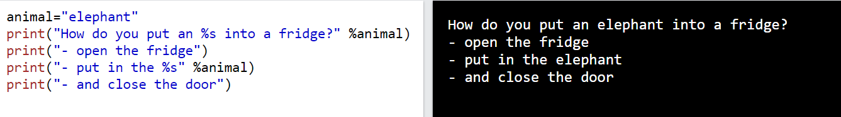
parameter

Slide 16
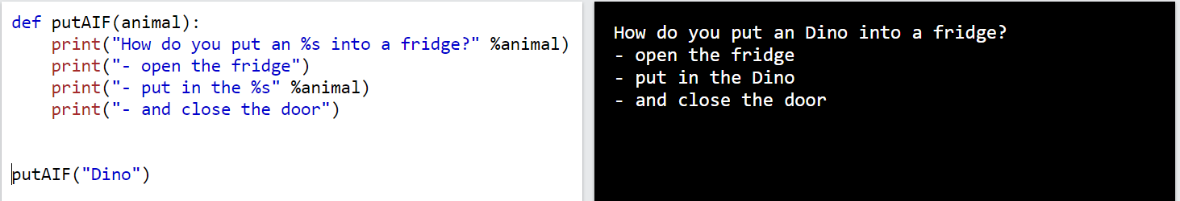
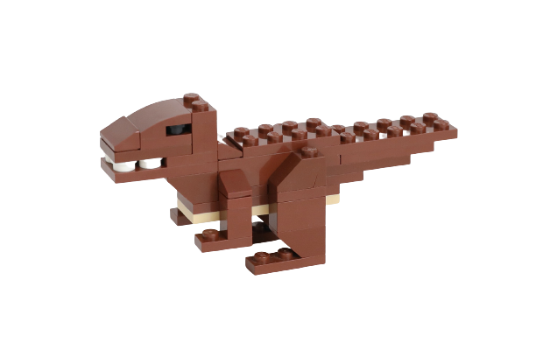
Project 1.1: Function putAIF

Slide 17
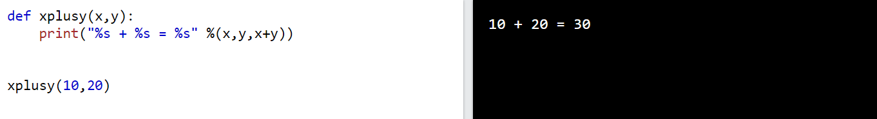
Try it yourself: Project 1.2: Function xplusy
Notes:
# for each line
“”” for paragraph “””

Slide 18
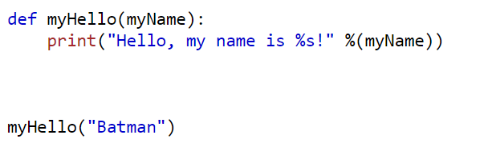
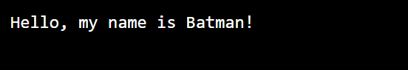
Try it yourself: Project 1.2: Function myHello
Notes:
# for each line
“”” for paragraph “””

Slide 19
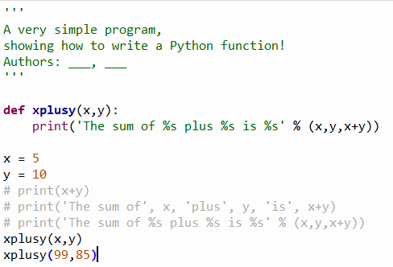
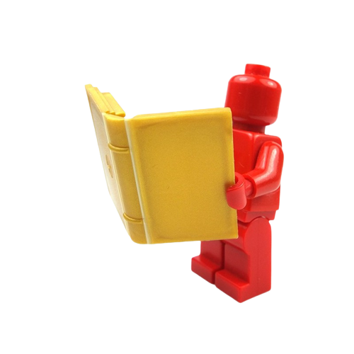
Comments in python
Appropriate names are self-explanatory!
Comments can be included for better human understanding.
Triple quotes for multiple lines
# for single line
Notes:
Most commonly, the initial documentation goes on for several lines, so a multi-line string delimiter is used (the triple quotes). Just for completeness of illustration in this program, another form of comment is also shown, a comment that starts with the symbol # and extends to the end of the line. The Python interpreter completely ignores this form of comment. Such a comment should only be included for better human understanding. Avoid making comments that do not really aid human understanding. (Do what I say, not what I did above.) Good introductory comment strings and appropriate names for the parts of your programs make fewer # symbol comments needed!
person = input('Enter your name: ')
print('Hello', person)

Slide 20
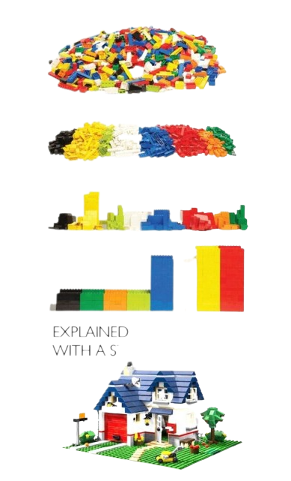
Agenda
Introduction to Programming
Tools we use for today
Project 1: function & parameters
Project 2: data visualization
Show your work!

Slide 21
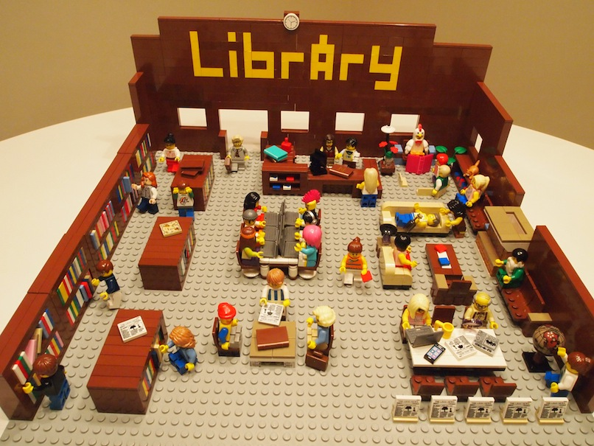
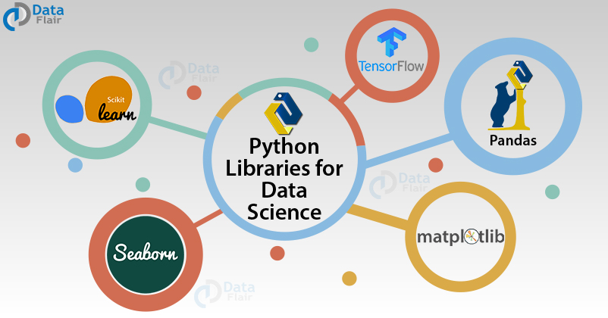
Library
Reuse functions
Preload data
Both above as a Library
Notes:
some 72,000 of them in the Python Package Index (PyPI) and still growing constantly
Pandas is a Python library that is used to analyze data.
Matplotlib is another Python library that is used for graph plotting as a visualization utility.

Slide 22
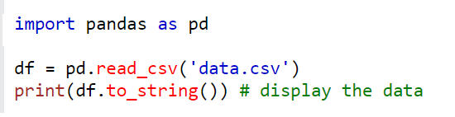
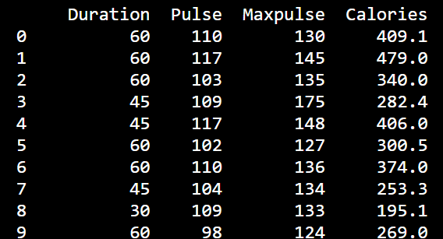
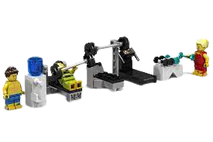
Load the sample data
https://www.w3schools.com/python/pandas/trypandas.asp?filename=demo_pandas_plot

Slide 23
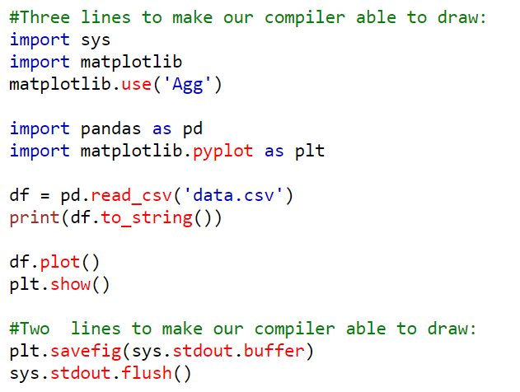
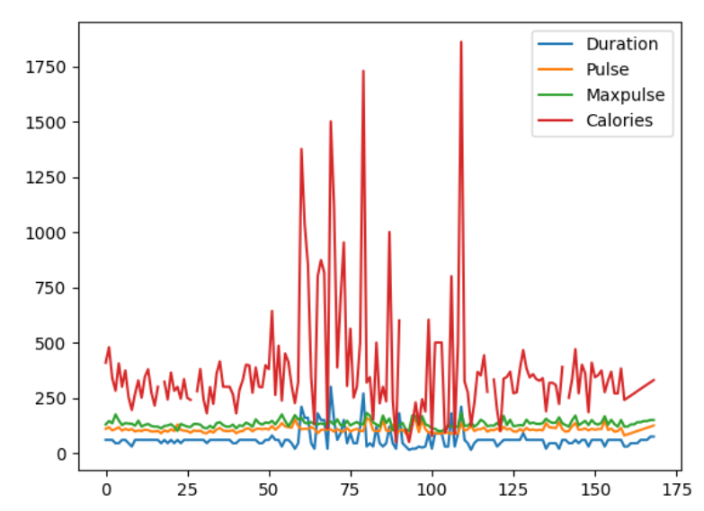
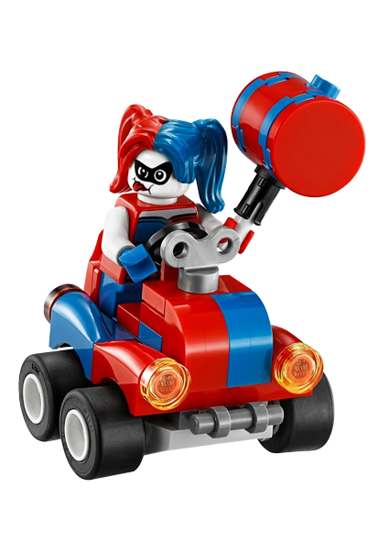
Plot all data points
Is the plot easy to understand?
Of course not!
It is horrible!
Notes:
print(df.shape)

Slide 24
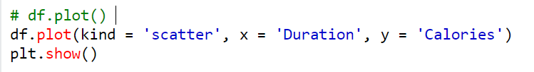
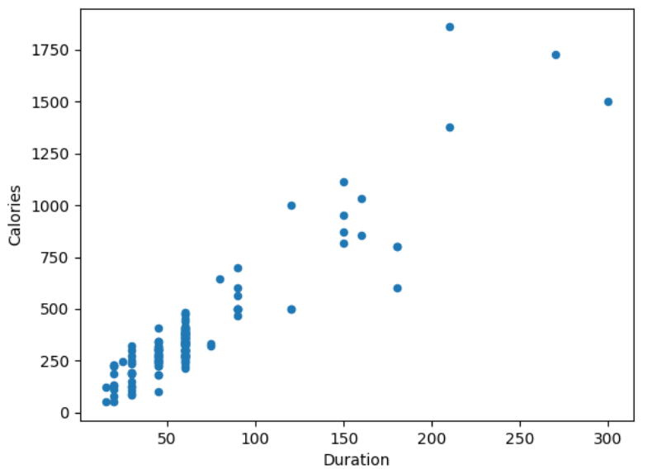

Try it yourself: Project 2: data visualization – 2 variables
We will use Duration for the x-axis and Calories for the y-axis to create a Scatter plot.

Slide 25
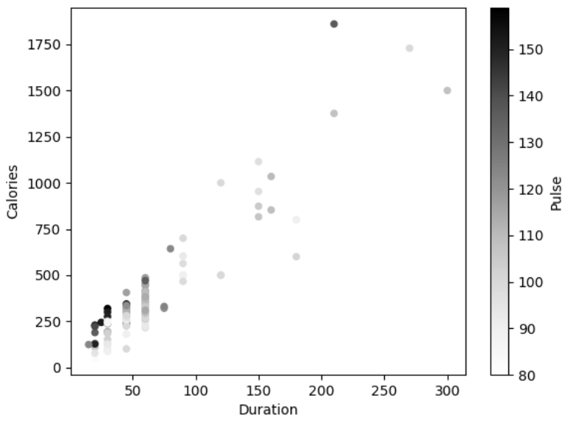
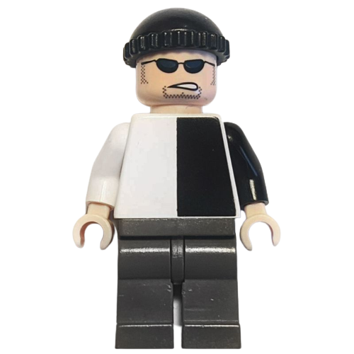

Project 2: data visualization – 3 variables
Add color level using 3rd variable Pulse

Slide 26
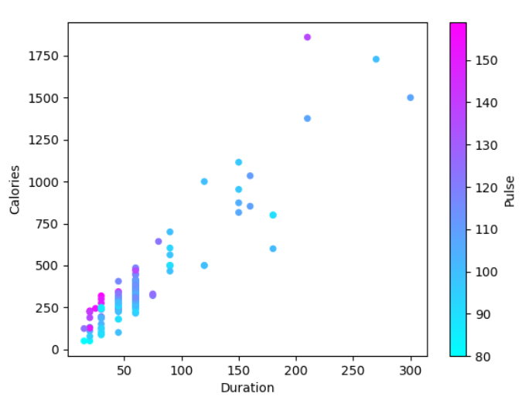
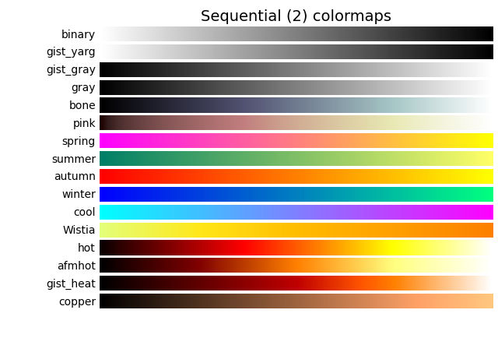
Project 2: data visualization - colormap
You can choose different colormap for better visualization

Slide 27
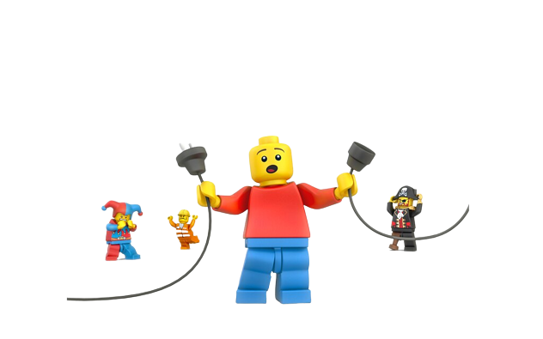
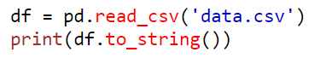
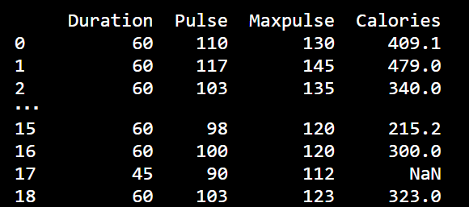
Project 2: data visualization – 4 variables
Add size using 4th variable Maxpulse
Check what caused the error in Maxpulse

Slide 28
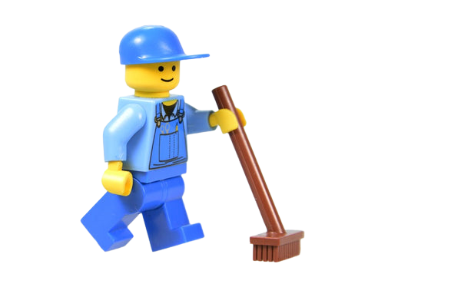
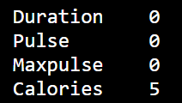
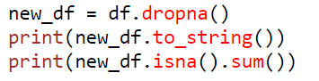
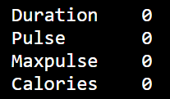
Project 2: data visualization – data cleaning
Bad data could be:
Empty cells
Data in the wrong format
Wrong data
Duplicates
Count the Empty Cells
Clean/remove the Empty Cells
Notes:
This is usually OK, since data sets can be very big, and removing a few rows will not have a big impact on the result.

Slide 29
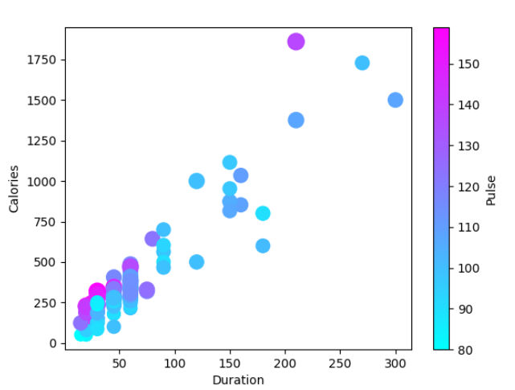
Project 2: data visualization – 4 variables
Add size using 4th variable Maxpulse
Notes:
Scatter plots traditionally show your data up to 4 dimensions – X-axis, Y-axis, Size, and Color. Of course you can do more (transparency, movement, textures, etc.) but be careful you aren’t overloading your chart.
print(new_df['Maxpulse'].min())
print(new_df['Maxpulse'].max())
new_df.plot(kind = 'scatter', x='Duration', y='Calories', s=new_df['Maxpulse’]-99, c='Pulse',colormap='cool');

Slide 30
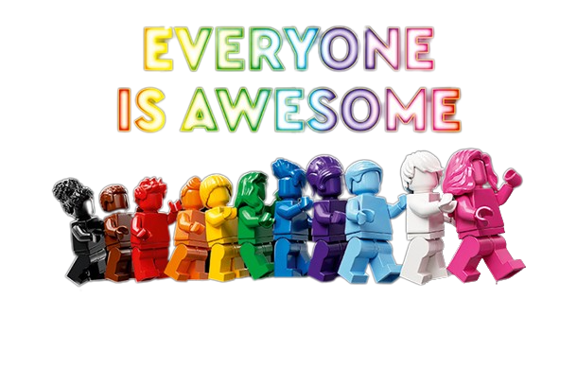
Agenda
Introduction to Programming
Tools we use for today
Project 1: function & parameters
Project 2: data visualization
Show your work! And Celebrate!

Slide 31

Congratulations Young BMS Programmers
Feel free to share all your future superpowers with us!

